Slide 1
CSC479
Data Mining
Lecture # 14
Classification
NAÏVE BAYES CLASSIFIER
(Ch # 8)

Slide 2
Bayes Classifier
A probabilistic framework for solving classification problems
calculate explicit probabilities for hypothesis
among the most practical approaches to certain types of learning problems
Incremental:
each training example can incrementally increase/decrease the probability that a hypothesis is correct
prior knowledge can be combined with observed data
A, C random variables
Joint probability: Pr(A=a,C=c)
Conditional probability: Pr(C=c | A=a)
Relationship between joint and conditional probability distributions
Bayes Theorem:

Slide 3
Bayesian Classifiers
Consider each attribute and class label as random variables
Evade C
Event space: {Yes, No}
P(C) = (0.3, 0.7)
Refund A₁
Event space: {Yes, No}
P(A₁) = (0.3, 0.7)
Martial Status A₂
Event space: {Single, Married, Divorced}
P(A₂) = (0.4, 0.4, 0.2)
Taxable Income A₃
Event space: R (real)
P(A₃) ~ Normal(μ,σ)
μ = 104:sample mean, σ²=1874:sample var

Slide 4
Bayesian Classifiers
Given a record X over attributes (A₁, A₂,…,A_{n})
E.g., X = (‘Yes’, ‘Single’, 125K)
The goal is to predict class C
Specifically, we want to find the value c of C that maximizes P(C=c| X)
Maximum A posteriori Probability estimate
Can we estimate P(C| X) directly from data?
This means that we estimate the probability for all possible values of the class variable.

Slide 5
BAYESIAN LEARNING
Naïve (Simple) Bayesian Classification
Suppose that there are m classes C₁, C₂, … C_{m}. Given an unknown data sample, X (i.e. having no class label), the classifier will predict that X belongs to the class having the highest posterior probability given X
Thus if P(C_{i}/X) > P(C_{j}/X) for 1 ≤ j ≤ m , j ≠ i
then X is assigned to C_{i}
This is called Bayes decision rule i.e. Assign X to C_{i} if
P(X/C_{i}) P(C_{i} ) > P(X/C_{j}) P(C_{j}) for 1 ≤ j ≤ m , j ≠ i
If P(Cj) are unknown then assume that all P(Cj) are equal to 1/m

Slide 6
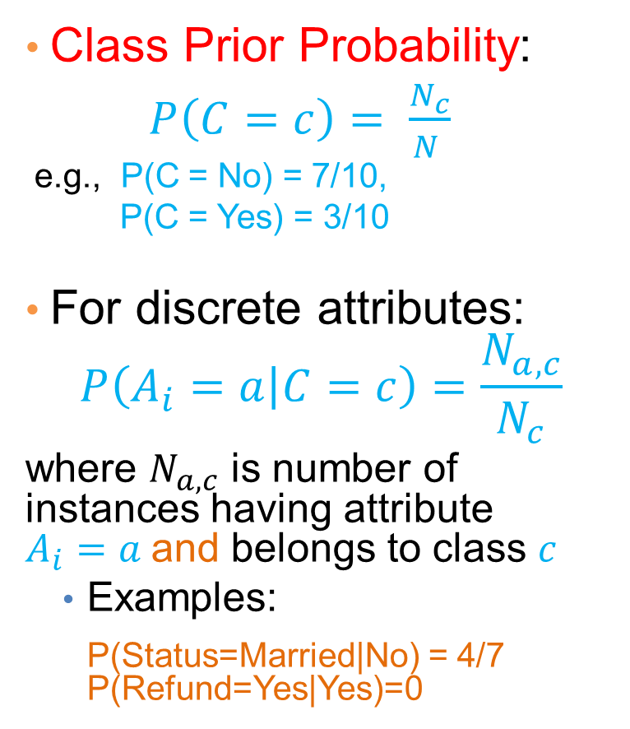
How to Estimate Probabilities from Data?

Slide 7
How to Estimate Probabilities from Data?
For continuous attributes:
Discretize the range into bins
one ordinal attribute per bin
violates independence assumption
Two-way split: (A < v) or (A > v)
choose only one of the two splits as new attribute
Probability density estimation:
Assume attribute follows a normal distribution
Use data to estimate parameters of distribution (i.e., mean μ and standard deviation σ)
Once probability distribution is known, we can use it to estimate the conditional probability P(A_{i}|c)

Slide 8
How to Estimate Probabilities from Data?
Normal distribution:
One for each (a_{i},c_{i}) pair
For (Income, Class=No):
If Class=No
sample mean = 110
sample variance = 2975

Slide 9
Example of Naïve Bayes Classifier
Creating a Naïve Bayes Classifier, essentially means to compute counts:
Total number of records: N = 10
Class No:
Number of records: 7
Attribute Refund:
Yes: 3
No: 4
Attribute Marital Status:
Single: 2
Divorced: 1
Married: 4
Attribute Income:
mean: 110
variance: 2975
Class Yes:
Number of records: 3
Attribute Refund:
Yes: 0
No: 3
Attribute Marital Status:
Single: 2
Divorced: 1
Married: 0
Attribute Income:
mean: 90
variance: 25

Slide 10
Example of Naïve Bayes Classifier
Given a Test Record:
P(X|Class=No) = P(Refund=No|Class=No) × P(Married| Class=No) × P(Income=120K| Class=No) = 4/7 × 4/7 × 0.0072 = 0.0024
P(X|Class=Yes) = P(Refund=No| Class=Yes) × P(Married| Class=Yes) × P(Income=120K| Class=Yes) = 1 × 0 × 1.2 × 10⁻⁹ = 0
P(No) = 0.3, P(Yes) = 0.7
Since P(X|No)P(No) > P(X|Yes)P(Yes)
Therefore P(No|X) > P(Yes|X) => Class = No

Slide 11
Naïve Bayes Classifier
If one of the conditional probability is zero, then the entire expression becomes zero
Probability estimation:
N_{i}: number of attribute values for attribute A_{i}

Slide 12
Example of Naïve Bayes Classifier
Given a Test Record:
With Laplace Smoothing
P(X|Class=No) = P(Refund=No|Class=No) × P(Married| Class=No) × P(Income=120K| Class=No) = 5/9 × 5/10 × 0.0072
P(X|Class=Yes) = P(Refund=No| Class=Yes) × P(Married| Class=Yes) × P(Income=120K| Class=Yes) = 4/5 × 1/6 × 1.2 × 10⁻⁹
P(No) = 0.7, P(Yes) = 0.3
Since P(X|No)P(No) > P(X|Yes)P(Yes)
Therefore P(No|X) > P(Yes|X) => Class = No

Slide 13
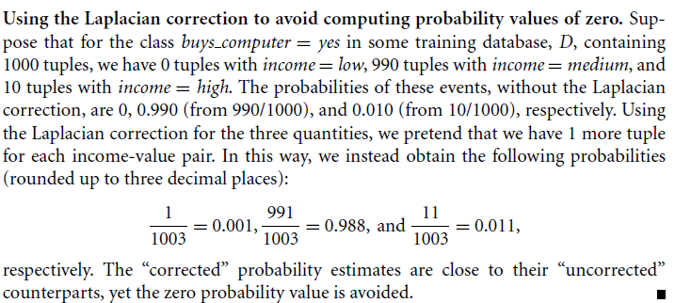
Example of Laplacian correction
In order to avoid probability values of zero we can add one value to each category of the attribute with zero count category.
Examples 8.5:

Slide 14
Naïve Bayesian classification – Example
Estimating P(x_{i}|C)
P(p) = 9/14
P(n) = 5/14

Slide 15
Naïve Bayesian classification – Example
Classifying X:
an unseen sample X = <rain, hot, high, false>
P(X|p)·P(p) = P(rain|p)·P(hot|p)·P(high|p)·P(false|p)·P(p) = 3/9·2/9·3/9·6/9·9/14 = 0.010582
P(X|n)·P(n) = P(rain|n)·P(hot|n)·P(high|n)·P(false|n)·P(n) = 2/5·2/5·4/5·2/5·5/14 = 0.018286
Sample X is classified in class n (don’t play)

Slide 16
Naïve Bayes (Summary)
Robust to isolated noise points
Handle missing values by ignoring the instance during probability estimate calculations
Robust to irrelevant attributes
Independence assumption may not hold for some attributes
Use other techniques such as Bayesian Belief Networks (BBN)
Naïve Bayes can produce a probability estimate, but it is usually a very biased one
Logistic Regression is better for obtaining probabilities.

